Slide 1
The Tower of Hanoi Legend:
From Analytics to Algorithms
Prof. Xiaohui Tao and Dr. Tianning Li
Computing discipline
School of Science, Engineering, and Digital Technologies
University of Southern Queensland

Slide 3
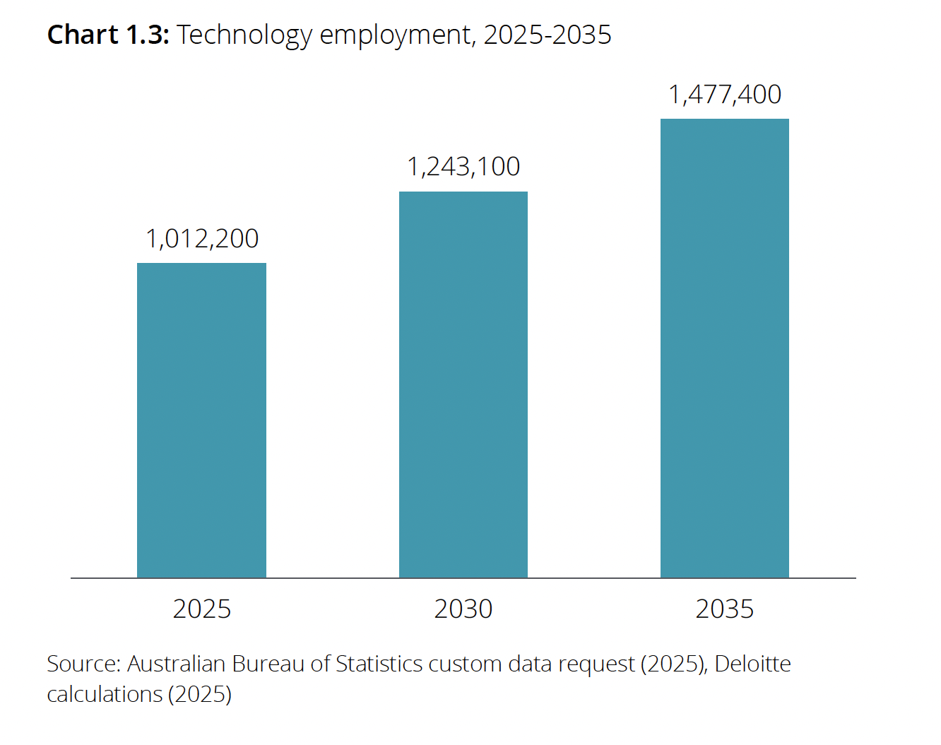
Technology workers enabling the digital economy
ACS Australia’s Digital Pulse 2025

Slide 4
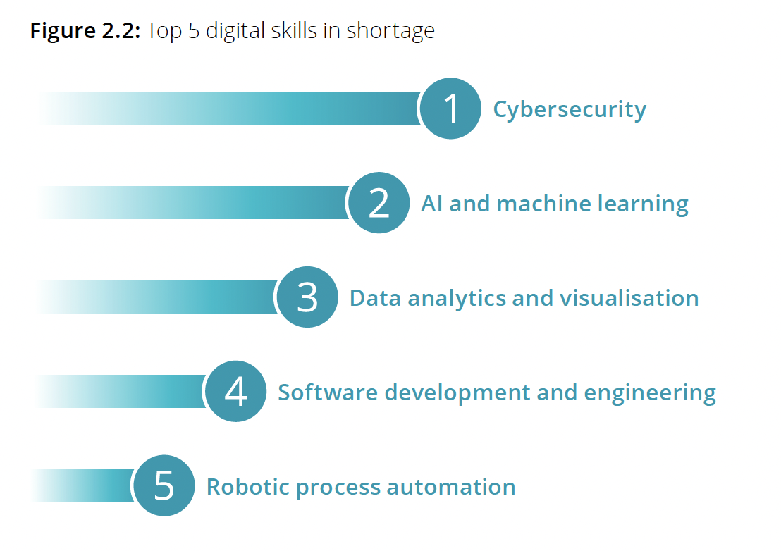
Digital skills gaps are holding businesses back
ACS Australia’s Digital Pulse 2025

Slide 5
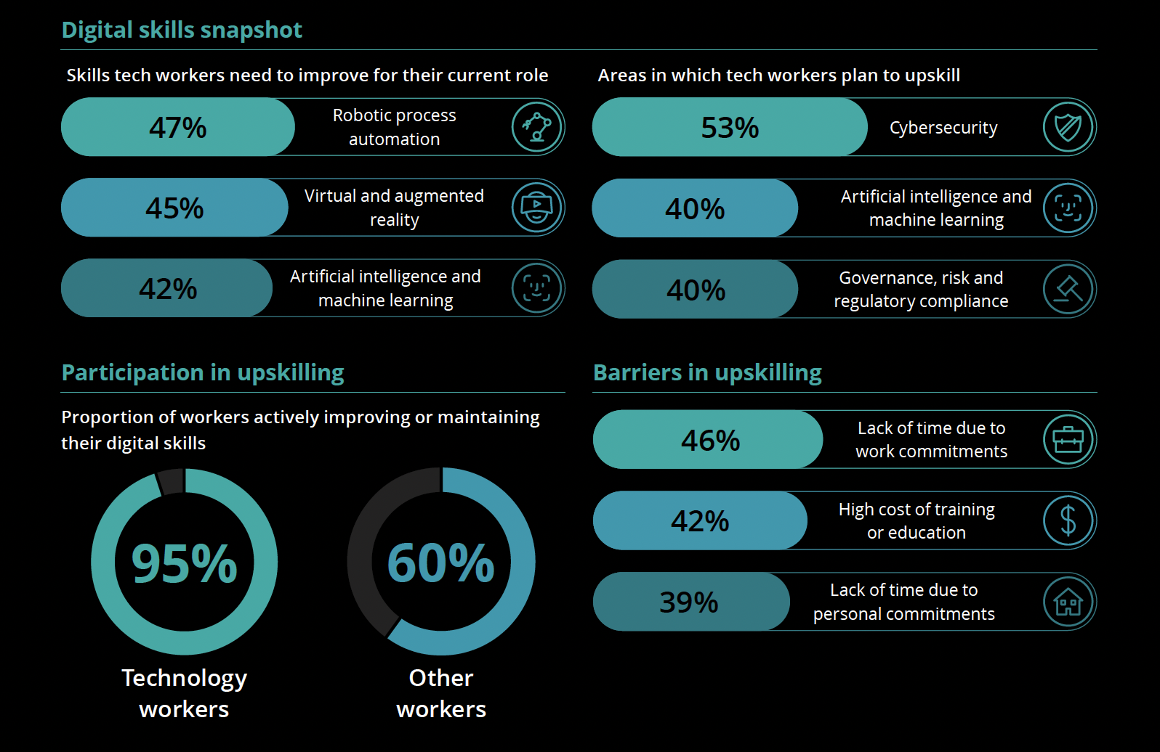

ACS Australia’s Digital Pulse 2025

Slide 6
A degree in Computing will help you unlock your future
Versatile Career Pathways
Future-Proof Skill Set
Global Opportunities
Innovative & Entrepreneurship
Leadership in Digital Transformation
Interdisciplinary Impact
Lifelong Learning Mindset
Strong Earning Potential

Slide 7
Why UniSQ for Computing?
Accredited, Innovative, Career-Ready
Fully ACS Accredited Degrees
Industry Partnership & Work Experience
Flexible Study Modes
Research-informed Teaching
Outstanding Graduate Outcomes
Top-tier Student Satisfaction
Generous Scholarship & Student Support
Vibrant Alumni & Community

Slide 8
Featured scholarships
Indigenous Student Success Program (ISSP) - Education Costs and Accommodation Costs Scholarships
Study Support Grant
UniSQ Residential College Scholarship
Chancellor's Excellence Scholarship
Vice-Chancellor's Excellence Scholarship
Incoming Study Abroad International Travel Grant
Domestic and International MRES Scholarship
Domestic PhD Stipend Scholarship
International Stipend and Fee Research Scholarship (DPHD)
International Student Support Scholarship
Access Excellence Scholarship
First Nations Scholarship
Goondiwindi Region Scholarship
John Ross Clancy Indigenous Student Bursary
Kevin Charlesworth Scholarship
MacIntyre Wind Farm Scholarship
Maha Sinnathamby AM Scholarship
Nola Charlesworth Bursary
Rachael Fontana and Tania Fontana-Marshall Scholarship
Regional Leaders Scholarship

Slide 9

Computing Discipline
(AI, Data Science, and IT)
Academic staff members actively participating in the research and education on Computer Science, Data Science, and Artificial Intelligence including a member of College of Experts, Australian Research Council
HDR students: 50+ PhD students and many Master by Research students
Competitive Research Grants: more than $6 million dollars in the past 5 years
  Sources and research partners include Australian Government agencies, Chinese Academy of Sciences, India Government agencies, QLD Health, CSIRO, CRC, enterprises and organisations in industry, etc.
Quality publications: 100+ top-tier journal articles and conference papers a year
  Transactions and journals: TPAMI, TKDE, TNNLS, TOIS, TMIS, TIST, INFFUS, IPM, etc.
  Top conferences: AAAI, CVPR, ICLR, IJCAI, ICDE, ICDM, SIGIR, SIGKDD, WWW, VLDB, etc.

Slide 10
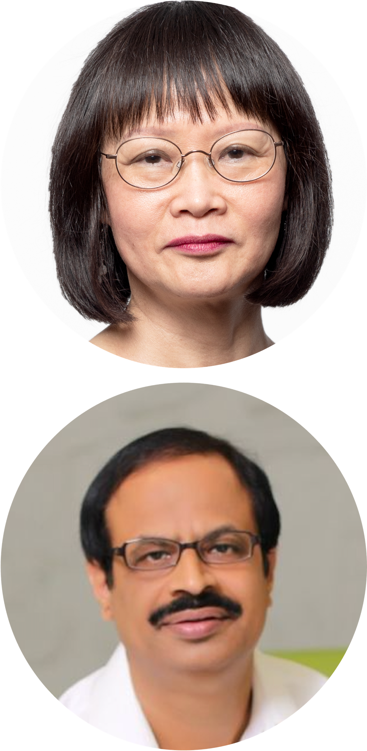
Teaching Excellence
Computing Discipline (AI, Data Science, and IT)
Professor Yan Li
        Member of the Australian Research Council’s Artificial Intelligence – Opportunity, Best Practice and Risk working group for its Insight Capability Working Groups
        280+ publications, 30+ PhD completions, $5 million research grants
Professor Rajendra Acharya
  Fellow of IAPR and AAIA
  Ranked #95 globally and #2 in Australia in 2025 and 2026 research.com list of Computer Ccience researchers
  Ranked top 1% of highly cited researchers for the last seven years in the field of computer science
  1000+ publications, over 115,000 citations with h-index of 169

Slide 11
Your UniSQ Experience in Computing Study
ACM, IEEE, ScienceDirect Digital Libraries
Internship & Capstone Projects on Real-world Problems
Hands-on, Experiential Learning & Practice
Unique & Personalised Education

Slide 12
Bachelor of Information Technology (BITC)
Three years program, 8 foundation core, 8 major courses, and 8 electives (or 2nd major)
Commonwealth supported, domestic full fee paying, and int’l full fee paying
ACS ICT Professional accreditation
Three majors: Software Application; Artificial Intelligence and Data Science; Networking and Cyber Security with strengthened focus on Student soft-skills and attributes and Industry informed knowledge
Entry requirement: English, General Maths
Related degree: BSCI-Computing (8-unit major)
Possible job titles: computing officer, software engineer, programmer, system administrator, network engineer, IT support, computer operator, database developer/administrator, software tester, Web developer, system analyst, etc.

Slide 13
Master of Information Technology (MCTN)
Two years program, 4 cores, 4 intermediate and 4 advanced specialisation courses, and 4 electives
Commonwealth supported, domestic full fee paying, and int’l full fee paying
ACS ICT Professional accreditation
Three specialisations: Software Development; Network Engineering; Computing Technology
Entry requirement: IELTS 6.0+, Australian university three-year Bachelor degree in any area, or equivalent; or A minimum of five years’ professional work experience
Pathway to PhD with taking research project (4 units) as electives
Possible job titles: computing officer, software engineer, programmer, system administrator, network engineer, IT support, computer operator, database developer/administrator, software tester, Web developer, system analyst, etc. (towards their senior position)

Slide 14
Master of Data Science (MADS)
Two years program, 8 cores, 4 specialisation courses, and 4 electives
Commonwealth supported, domestic full fee paying, and int’l full fee paying
ACS ICT Professional accreditation
Two specialisations: Artificial Intelligence and Machine Learning; Data Analytics
Entry requirement: IELTS 6.0+, Australian university three-year Bachelor degree in any area, or equivalent; or A minimum of five years’ professional work experience
Pathway to PhD with taking research project (4 units) as electives
Possible job titles: Data Scientist, data analyst, machine learning engineering, AI engineer, data visualisation specialist, BI analyst/consultant, data solution architect, data engineer, data quality and integrity specialist, data operation manager, data modeller, etc.

Slide 15
Master of Cyber Security (MCYS)
Two years program, 8 core courses, 4 specialisation courses, and 4 electives
Domestic full fee paying and int’l full fee paying
ACS ICT Professional accreditation
Two specialisations: Cyber security management; Technical specialisation
Entry requirement: IELTS 6.0+, Australian university three-year Bachelor degree in any area, or equivalent; or A minimum of five years’ professional work experience
Pathway to PhD with taking research project (4 units) as electives
Possible job titles: cybersecurity analyst, digital forensic, information security officer, Penetration Tester, cybersecurity engineer, Security Compliance Officer, Cyber Operations and Information Security Manager, Business Analyst (Cyber Security), Cyber Security Consultant, etc.

Slide 16
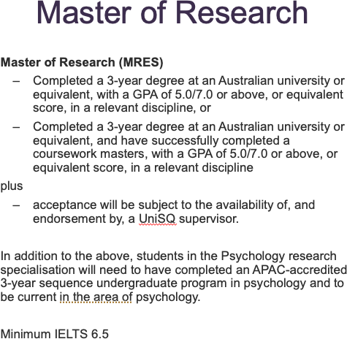
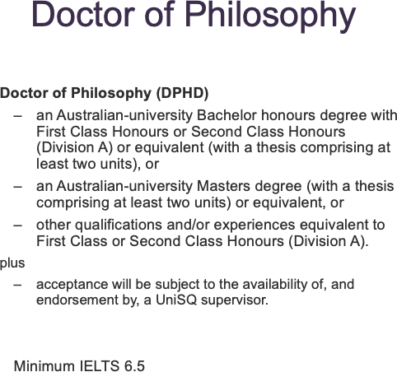
Higher Degree of Research (HDR) Programs

Slide 17
Summary
Why study Computing?
Why study Computing at UniSQ?
Your UniSQ experience in Computing study
Computing programs

Slide 18
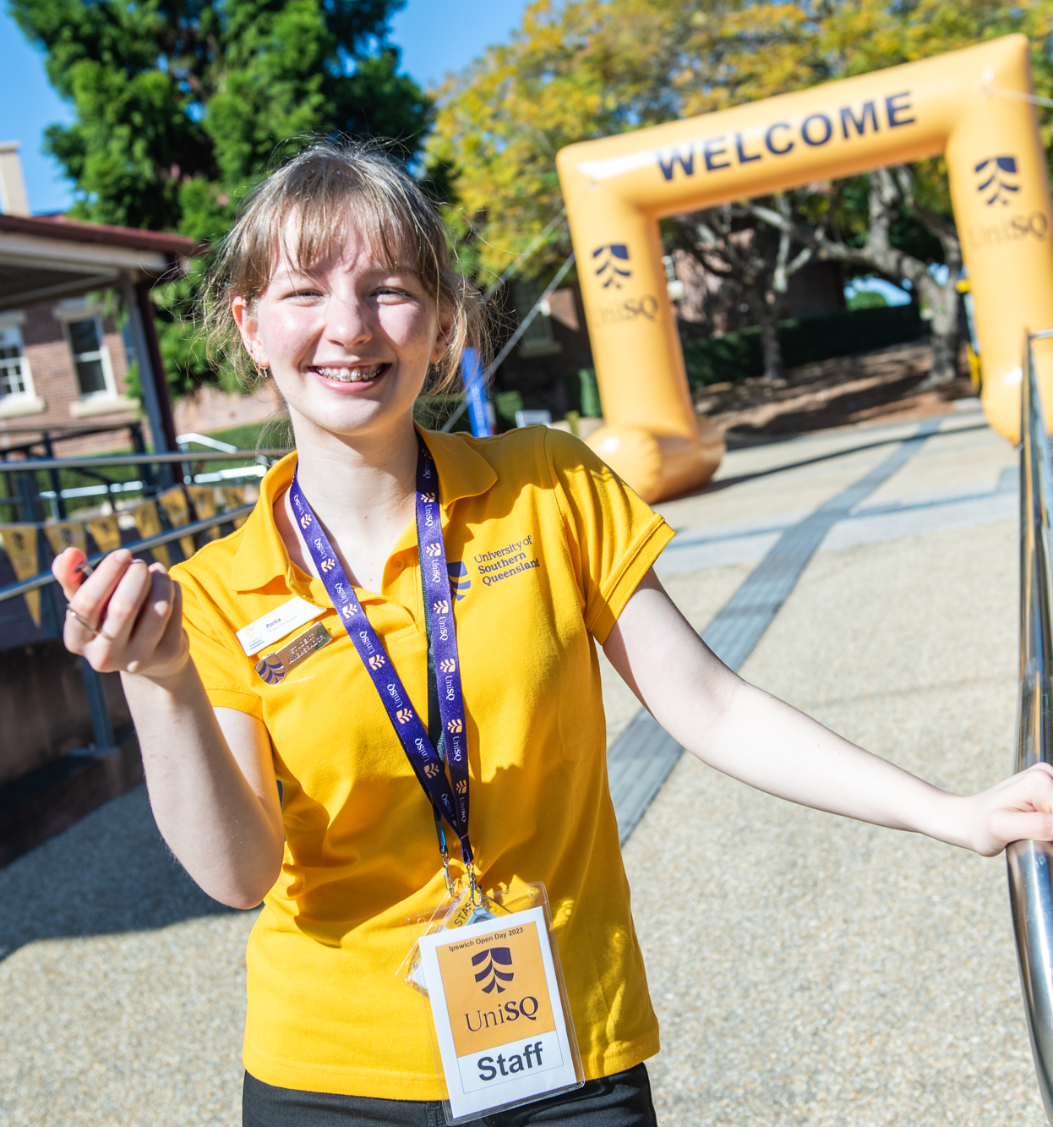
Thank you for attending this session.
Please feel welcome to ask questions.

